Slide 1
CRUDE OIL PRICE PREDICTION
P 131 – Group 6
Sumit Siddaling Masanaik
Chinmai Shivaji Dandeka
Bhupendra singh sidar
Siddesh S
Ashvin Arvind Dumbre
G Raghavendra Prasad

Slide 2
CRUDE OIL WTI FUTURES DATA
WTI - West Texas Intermediate
WTI refers to oil extracted from wells in the U.S. and sent via pipeline to Cushing, Oklahoma.
The fact that supplies are land-locked is one of the drawbacks to West Texas crude as it’s relatively expensive to ship to certain parts of the globe.
The product itself is very light and very sweet, making it ideal for gasoline refining.
WTI continues to be the main benchmark for oil consumed in the United States and World.
The dataset used for this project is from -
https://in.investing.com/

Slide 3
PROBLEM STATEMENT
- To predict the price of Crude Oil WTI .
Variables used are trading price of each day for past 20 years.
Variables :
1. Date
2. Price
3. Open
4. High
5. Low
6. Vol.
7. Change %

Slide 4
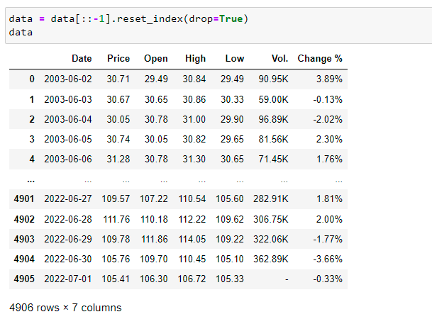
EDA (EXPLORATORY DATA ANALYSIS)

Slide 5
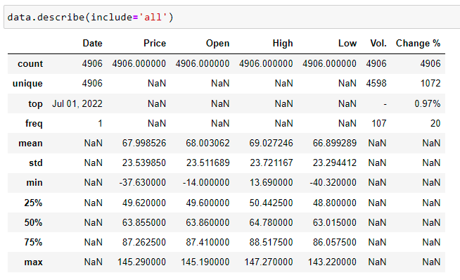

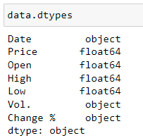
EDA

Slide 6
EDA (EXPLORATORY DATA ANALYSIS)
Initial EDA shows 4906 records and 7 features .
Descriptive statistics shows -
Mean Price : 67.99
Std Price : 23.53
Min Price : - 37.63
Max Price : 145.29

Slide 7
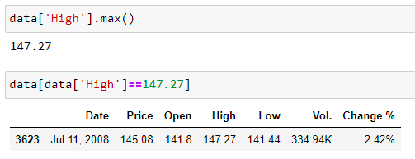
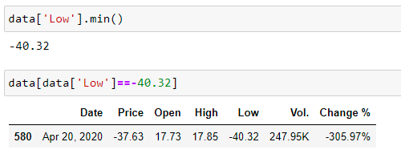
HIGHEST PRICE POINT
LOWEST PRICE POINT

Slide 8
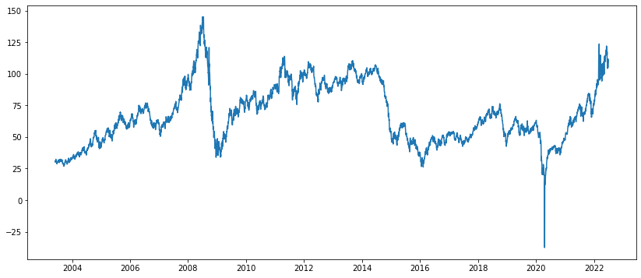
PRICE CHART
Date vs Price

Slide 9
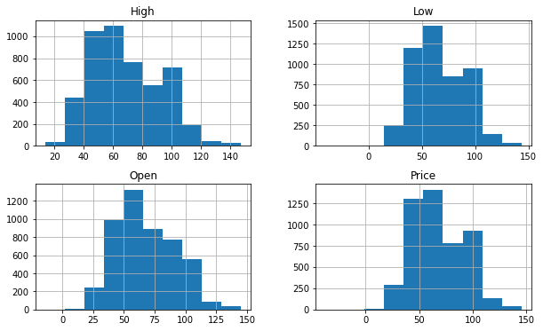
HISTOGRAPH
Most of the records are lying in range of 40 – 110 USD.

Slide 10
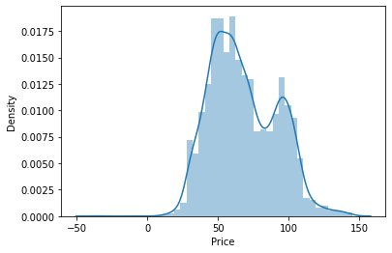
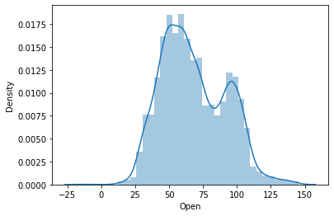
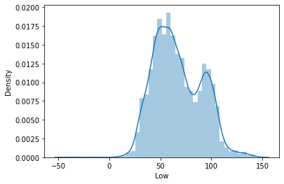
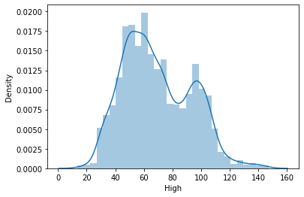
DENSITY OF DATA( PRICE, OPEN, LOW, HIGH )

Slide 11
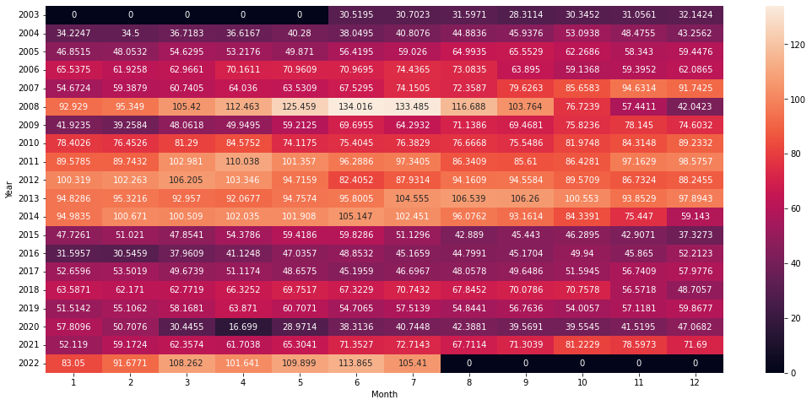
HEAT MAP TO CHECK AVERAGE PRICE AT EACH MONTH FOR EVERY YEAR
June 2008 oil price was maximum
April 2020 oil price was minimum.

Slide 12
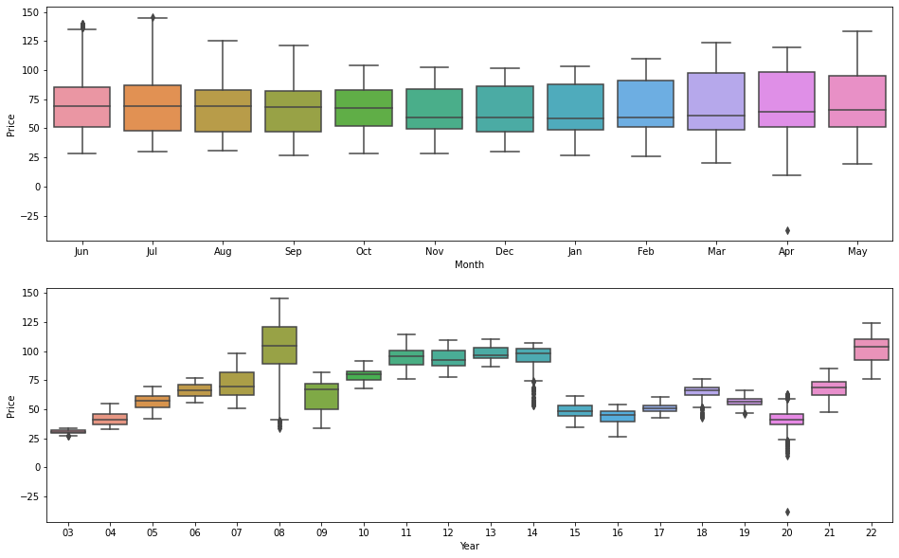
BOX PLOT TO CHECK FOR OUTLIERS
From boxplot we can see that we have most number of outliers in year 2014, 2018 and 2020

Slide 13
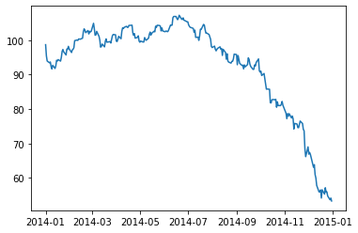
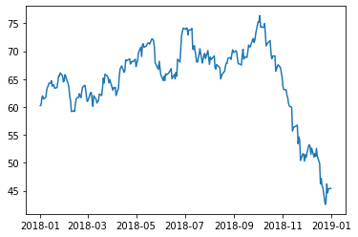
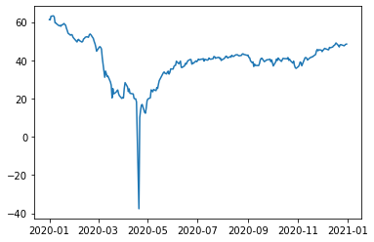
PLOTTING FOR 2014, 2018 AND 2020 TO KNOW HOW EXACTLY PRICE DISTRIBUTION IS
2014
2018
2020
2014 the oil price started dropping from July till end of the year
2018 oil price rapidly dropped from October to end of the year.
2020 due to covid the oil price reached its lowest price ever in history recording -40$ per barrel

Slide 14
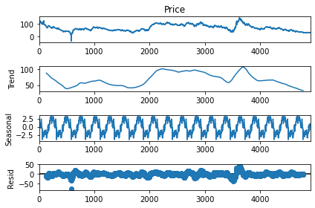
CHECKING FOR TREND AND SEASONALITY
Here we observed additive seasonality
No certain trend

Slide 15
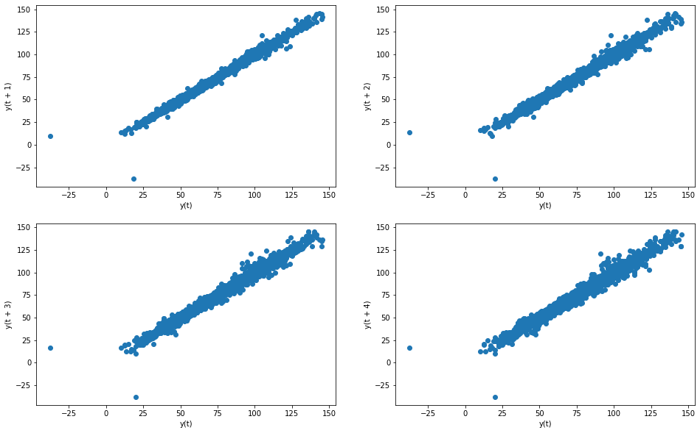
AUTOCORRELATION USING LAGPLOT
FROM LAGPLOT WE OBSERVE THAT TODAY'S PRICE IS HIGHLY CO-RELATED TO YESTERDAY'S PRICE

Slide 16
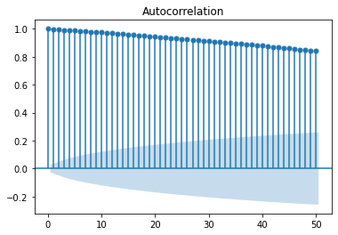
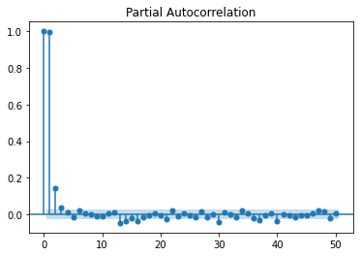
ACF & PACF PLOT
Auto-Correlation Function
Partial Auto-Correlation Function
In ACF all the observations are significant we can't use MA model,
We have many significant values in PACF plot too so we can't use AR model.
Here we will go with ARMA OR ARIMA model to forecast.

Slide 17
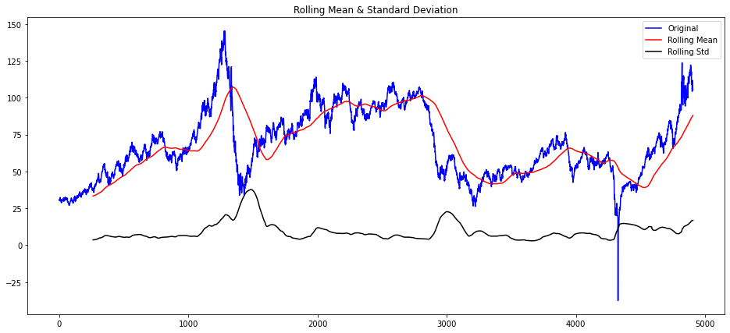
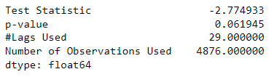
CHECK FOR STATIONARY OF DATA
Here out data is not stationary, so we used some transformation .
Dickey–Fuller test for calculating P-Value.
P-value is not in acceptance range.

Slide 18
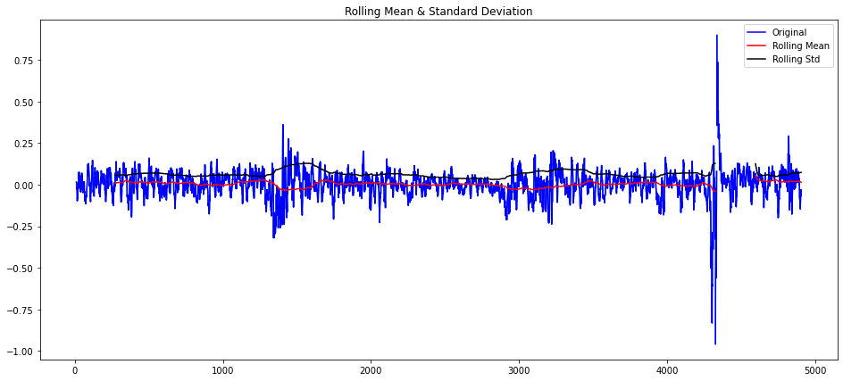
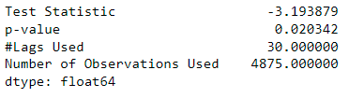
CHECK FOR STATIONARY OF DATA
Here out data is stationary, since we used log transformation with 1 difference.
Dickey–Fuller test for calculating P-Value
P-value is in acceptance range.

Slide 19
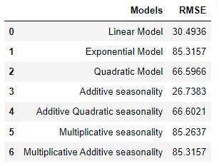
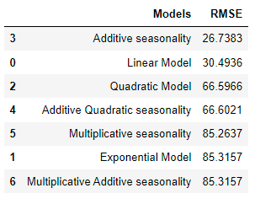
MODEL BASED FORECASTING
Results
Sorted Results
We built 7 Model based forecasting models and sorted them in ascending order.
From above table for Additive seasonality model, we got the less Root mean squared error.
So we will build model using Additive seasonality for whole data set.

Slide 20
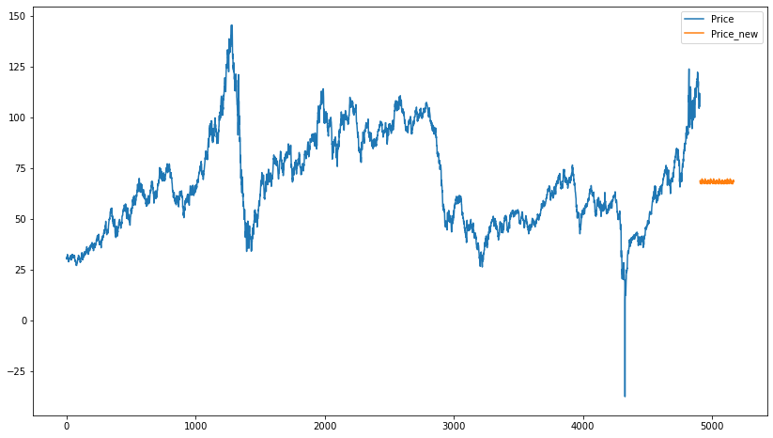
FORECAST FOR FUTURE USING ADDITIVE SEASONALITY MODEL
Here in our model for 2022-07-01 its forecasting a price of 68.5541 but in actual its 108.43 so we are facing a large difference so our model-based forecasting technique is failed.
so we will go for data driven forecasting techniques

Slide 21
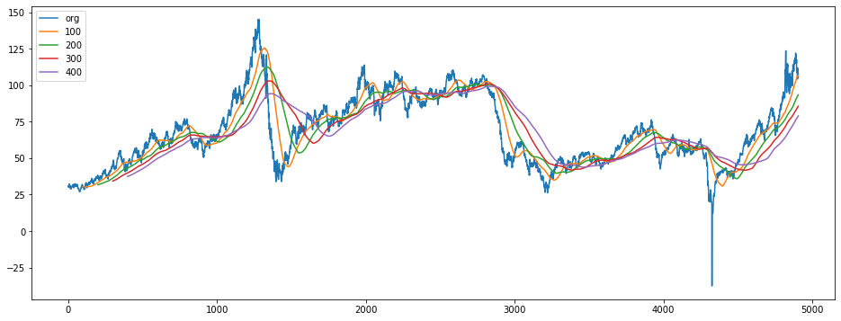
MOVING AVERAGE

Slide 22
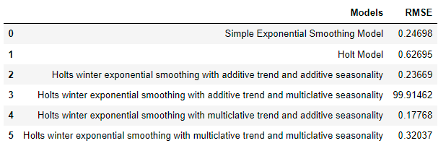
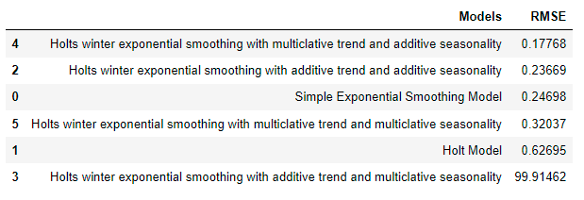
SORTED RESULT
DATA DRIVEN FORECASTING
RESULT

Slide 23
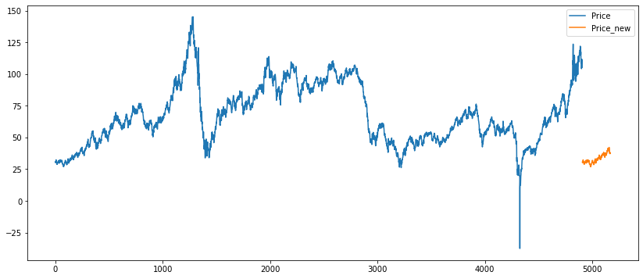
HOLTS WINTER MODEL WITH MULTIPLE SEASONALITY AND ADDITIVE TREND
Here our model for 2022-07-01 its forecasting a price of 30.7292 but in actual its 108.43 so we are facing a large difference, so our ARIMA Model is failed.
so, we will go for LSTM Model.

Slide 24
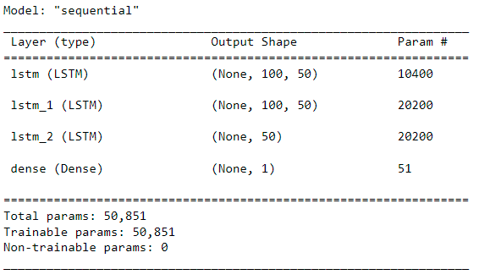
LSTM MODEL SUMMARY
Here we used 3 hidden layers and input shape 100 for first hidden layer

Slide 25
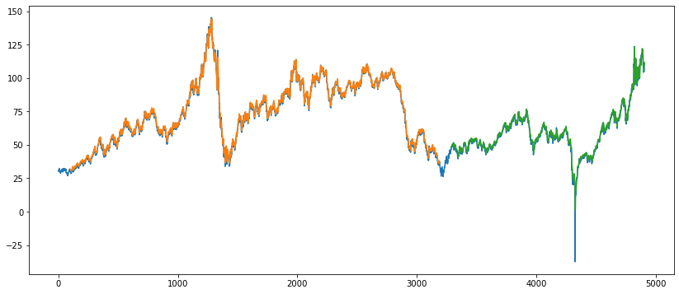
In above plot.
Blue line determine the actual values .
Orange line determine the predicted value for train data.
Green line determine the predicted values for test data.
LSTM is giving better results, so we finalize the LSTM model.

Slide 26
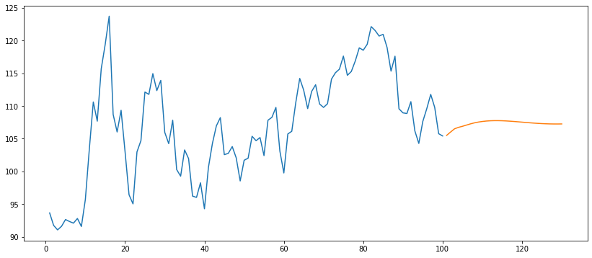
FORECAST DATA USING LSTM MODEL
The orange line shows the forecasted values for next 30 days based on previous 100 days records.
Here forecasted values are good.

Slide 27
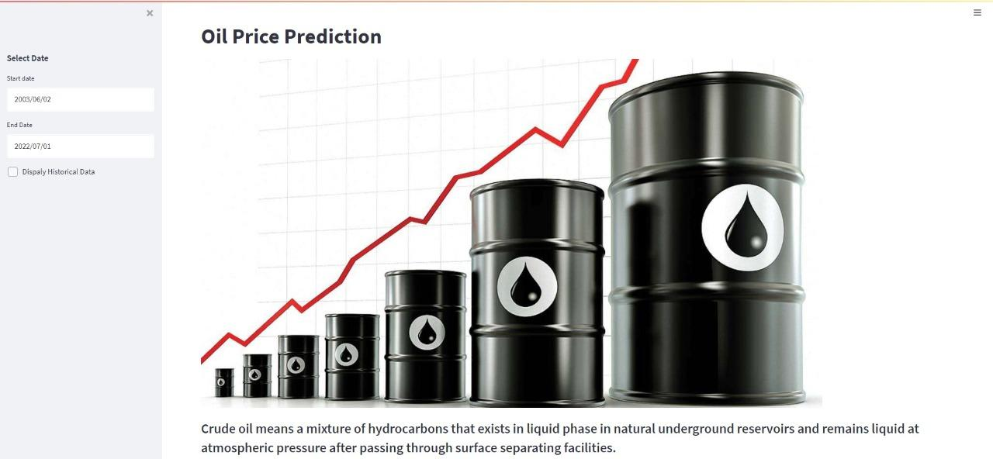
MODEL DEPLOYMENT
Web Interface.

Slide 28
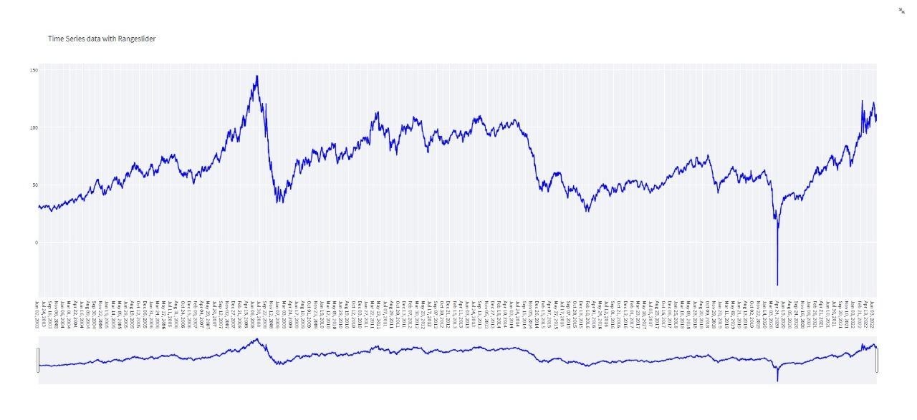
WTI – HISTORICAL PLOT
By using cursor on web page, we can see price for date

Slide 29
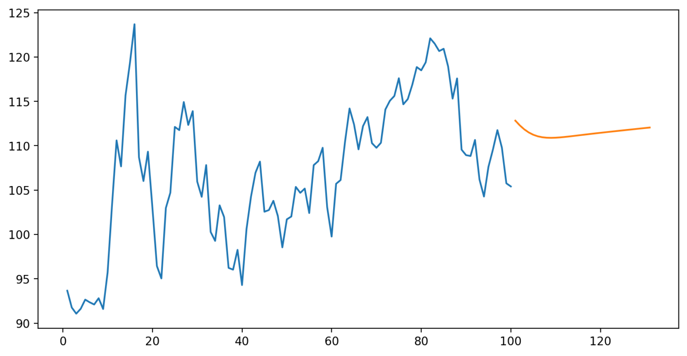
WEB INTERFACE FORECASTED RESULT
Blue Line represents past 100 days price.
Orange Line represents future 30 days price.

Slide 30
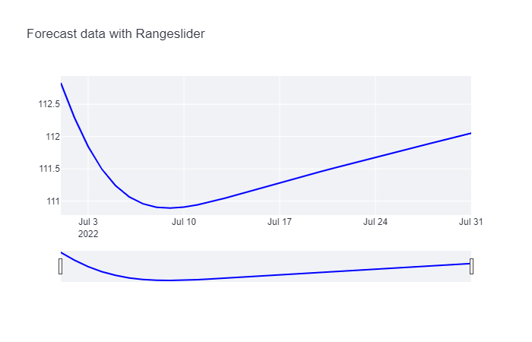
WTI – FORECATED PRICE FOR 30 DAYS
By using cursor on web page, we can see price for future dates

Slide 31
CHALLENGES FACED
Data collection
Low accuracy with basic models
Model selection
LSTM Model building
Implementation of tracer in the deployment

Slide 32
GITHUB LINK
Sumit Siddaling Masanaik : https://github.com/SumitMasanaik/
Chinmai Shivaji Dandeka : https://github.com/Chinmai-D10/
Bhupendra singh sidar : https://github.com/bss1211/
Siddesh S :
G Raghavendra Prasad :

Slide 33
THANK YOU!!

